Slide 1
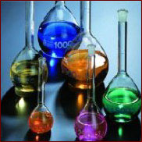
Lecture 2: Bonding in chemical compounds

Slide 2
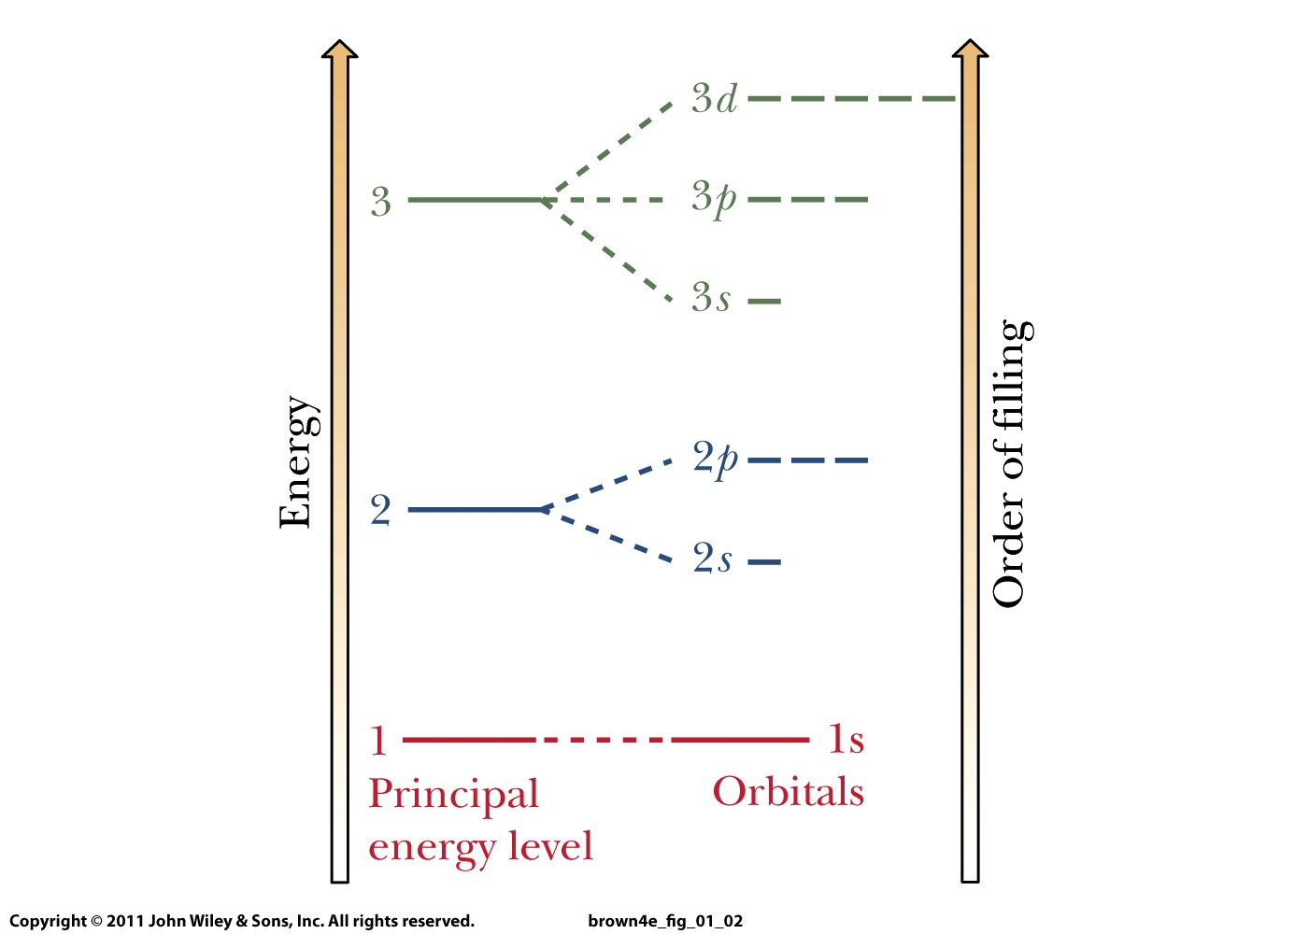
Rule 1: Orbitals fill from lowest energy to highest energy.
Rule 2: Only two electrons per orbital, spins must be paired.
Rule 3: For a set of orbitals with the same energy, add one electron in each before a second is added in any one.

Slide 3
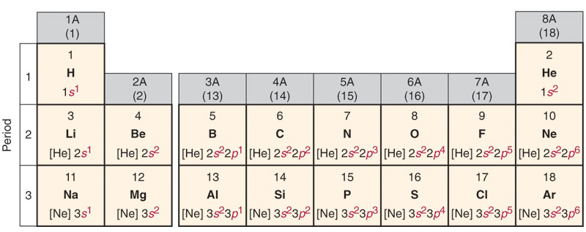
Cl :
1s²
2s²
2p⁶
3s²
3p⁵
[Ne] 3s² 3p⁵
condensed electron
configuration
Core electrons
Valence electrons:
determine elements’
chemical properties!
1s
2s
2p
3s
3p

Slide 4
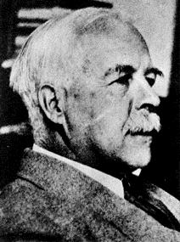
Gilbert Lewis, 1875-1946
Lewis atomic symbols:
Atomic symbol = nucleus
and inner shell electrons
Dots = valence electrons
H●
C●
●
●
●

Slide 5
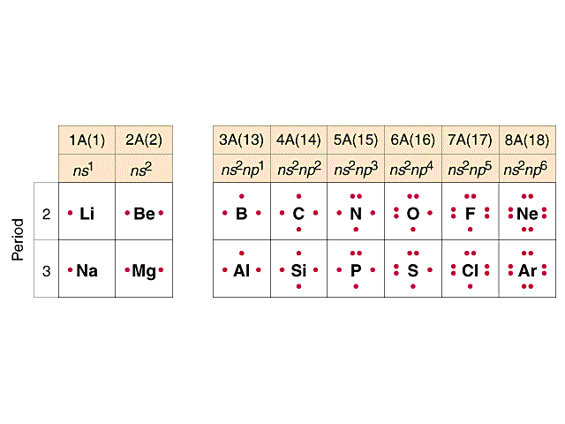
Lewis electron-dot structures
Number of dots = number of valence electrons
Elements in same column have similar chemical properties
Elements with full shells (noble gases) are especially
stable and hence unreactive!

Slide 6
Octet rule:
Atoms bond together so that
each atom in the bond acquires
the electron configuration of
the noble gas nearest to
its atomic number.

Slide 7
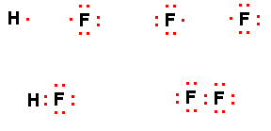
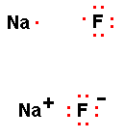
Transferring electrons creates ionic compounds:
Sharing electrons creates covalent compounds:
Non-bonding electrons
Lone pairs
Both now have
the electron
configuration
of Ne
Closed shells
Bonding pairs
Coulombic attraction

Slide 8
Chemical bond
The force that holds two atoms together in a compound
Scientists have three general models to describe these forces:
Ionic
Covalent
Metallic
How are these models distinguished?
By the distribution of the electrons among the atoms involved in the bonding.

Slide 9
Transferring electrons creates ionic compounds:
Sharing electrons creates covalent compounds:
Non-bonding electrons
Lone pairs
Closed shells
Bonding pairs
Coulombic attraction

Slide 10
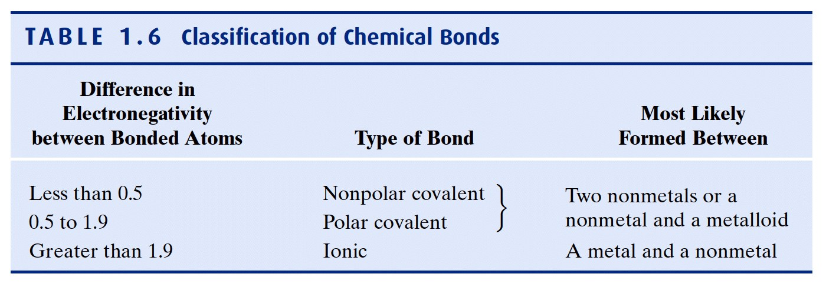
Which type of bonding occurs depends on the electronegativities of the elements = measure of the force of an atom’s attraction for electrons it shares in a chemical bond with another atom
NOTE: Sapling homework uses 1.7 as the border between covalent and ionic bond!

Slide 11
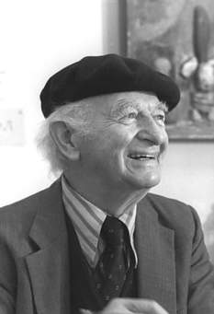
Linus Pauling 1901 – 1994
Noble Prize in Chemistry: 1954
Noble Peace Prize: 1962
Caltech
Most commonly used
electronegativity scale (1930’s):
F: 4.0; most electronegative atom
Notes:
Vitamin C; only person ever to get two unshared Noble Prizes

Slide 12
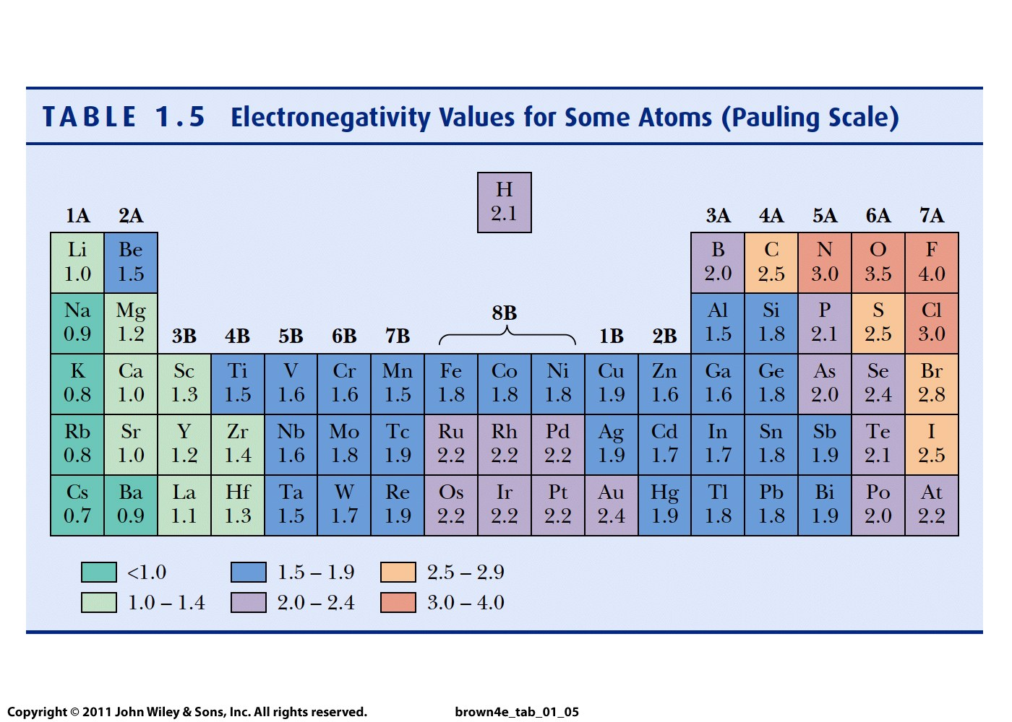

Slide 13

e transfer occurs from the atom of lower electronegativity
to the atom with greater electronegativity

Slide 14
Lewis electron-dot structures
For metals, number of dots = number of electrons it loses
What is the Lewis structure for Ca?
How many electrons does it tend to lose?
For non-metals, the number of dots reveals the number of electrons it can receive or share to achieve an octet
What is the Lewis structure of O?
How many electrons does it tend to gain?
..
..
● Mg ● → Mg ²⁺ + 2 e⁻
..
..
..
●
..
●
●
●
O + 2e⁻ → O ²⁻
..
●
●
..
●
●
●
●
●
●
●
●

